Slide 1
The aim of your search…
Reproduction revision search
The aim of your search is to reach as many points as you can (minimum 10 points). Set yourself a challenging target though!
Each activity has a points score and a task number in the top corner.
Write your answer in your book.
If you are not sure about your answer, see if you can help yourself by using your book, or ask a buddy to help.

Slide 2
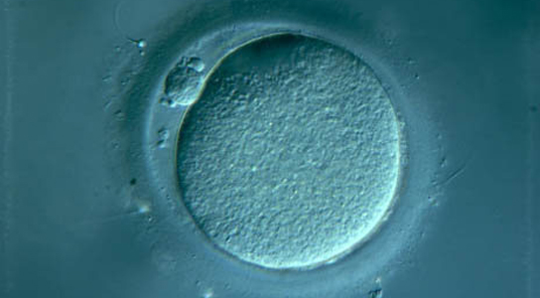
1 Point
Task 1
State which this cell is – egg or sperm.
2 points
Describe a difference between egg and sperm cells.

Slide 3
1 Point
Task 2
A fertilised egg develops into an embryo – TRUE or FALSE?
2 points
What does an embryo develop into in the uterus? (Use the correct scientific term.)

Slide 4
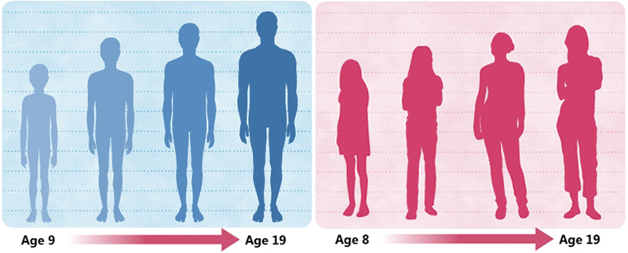
1 Point
Task 3
Describe two changes that occur during puberty.
2 points
Explain what causes puberty to happen and what occurs as a result.

Slide 5
1 Point
Task 4
Which spelling is correct?
Pregant Pregnant Preggnant
2 points
Which order do the following have to occur in to result in pregnancy?
IMPLANTATION FERTILISATION EJACULATION

Slide 6
1 Point
Task 5
Chickens use internal fertilisation – true or false?
2 points
Correct this sentence (for spelling and science!)
Internal fertilisation needs sperm cells to be ferilised by egg cells.

Slide 7
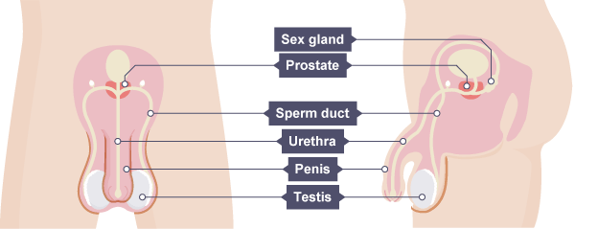
1 Point
Task 6
Which label is missing from the diagram?
2 points
Describe the job of two of the above part labelled above.

Slide 8
1 Point
Task 7
State which of the features below apply to egg cells.
  Made in organs that hang outside the body
  Start to be released between ages 10-18
  Made in ovaries
2 points
Explain which of the above statements is the odd one out and why.

Slide 9
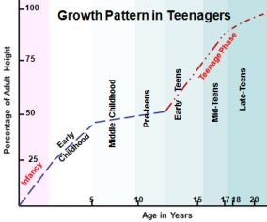
1 Point
Task 8
When does a human grow the fastest?
2 points
Suggest how scientists collected information to draw the above graph

Slide 10
1 Point
Task 9
Who tends to start puberty earlier – girls or boys?
2 points
Why do children need to go through puberty?

Slide 11
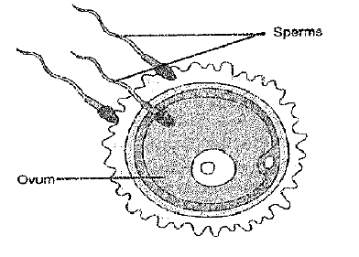
1 Point
Task 10
What does the diagram show?
2 points
State the place in the woman where this occurs and what happens to the fertilised egg afterwards.

Slide 12
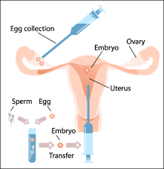
1 Point
Task 11
Where does the syringe pass through to put the embryo back into the mother?
2 points
Why is only one embryo put into the uterus instead of several?

Slide 13
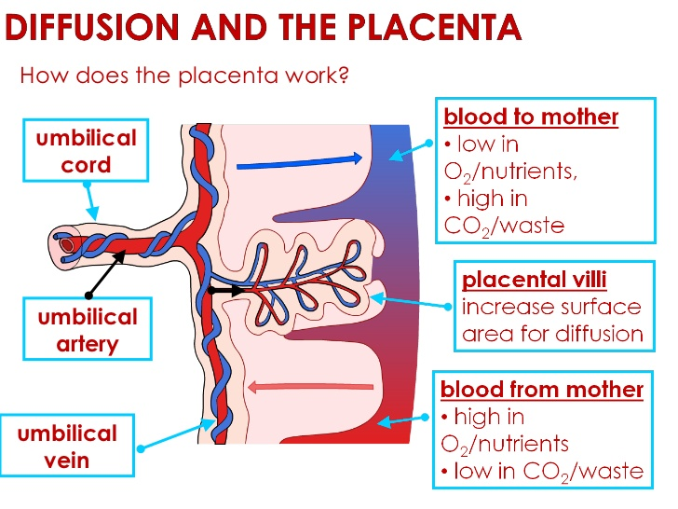
1 Point
Task 12
Name a substance that passes from fetus to mother across the placenta
2 points
Suggest what might happen if the placenta did not function correctly.

Slide 14
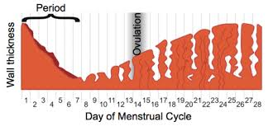
1 Point
Task 13
What day does ovulation happen?
A
2 points
Describe what section A shows on this diagram.

Slide 15
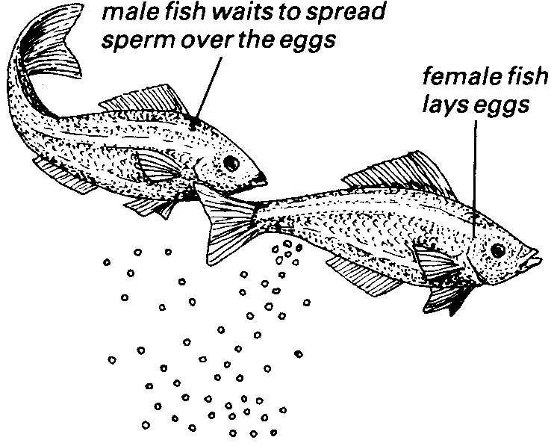
1 Point
Task 14
What type of fertilisation is this - INTERNAL or EXTERNAL?
2 points
Why do fish lay so many eggs?

Slide 16
Reflection time
How did you do? Did you reach your target?
What have you learned that you didn’t know before you started your search?
Set yourself an achievable target for next lesson.

